Slide 1

Green Pace
Security Policy Presentation
Developer: Liu, Kevin

Slide 2

OVERVIEW: DEFENSE IN DEPTH

Slide 3
THREATS MATRIX
Input Validation Failure | Ignoring Compiler Warnings
Data Not Sanitized Before Output | Over-engineering (Too Many Layers)
Likeliness
Priority

Slide 4
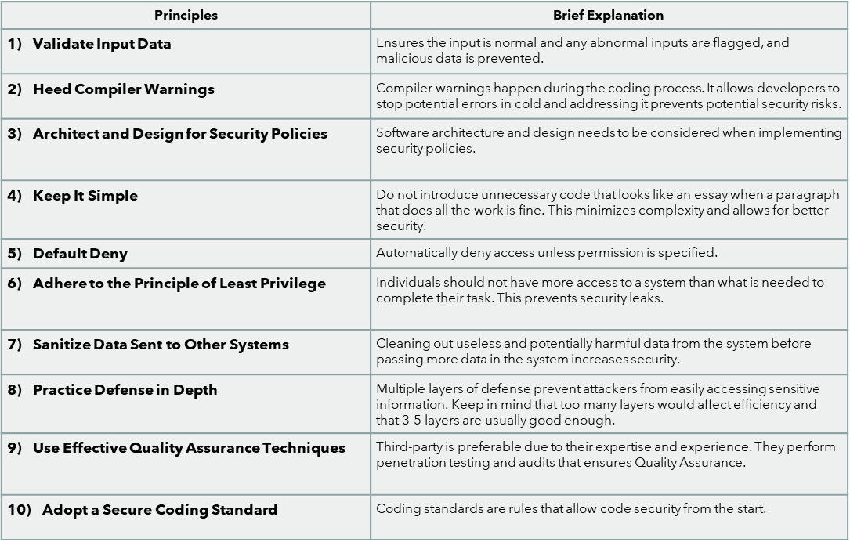
10 PRINCIPLES

Slide 5
CODING STANDARDS
Validate Input Data
Sanitize Data
Principle of least privilege
Default Deny
Architect and Design
Defense in Depth
QA
Compiler warnings
Secure Coding Standard
Keep it Simple

Slide 6
ENCRYPTION POLICIES
Encryption in Flight: All data transmitted between users, applications, and services will be encrypted with TLS 1.2 or higher. Preventing sensitive information from interception during transmission.
2. Encryption at Rest: Data stored in databases, file systems, and backups will be encrypted using AES-256 or better. Preventing unauthorized access to stored data even when the storage media is compromised.
3. Encryption in Use: Sensitive data, will use trusted execution environments (TEEs) to protect data integrity. This adds an extra layer of security during operations.

Slide 7
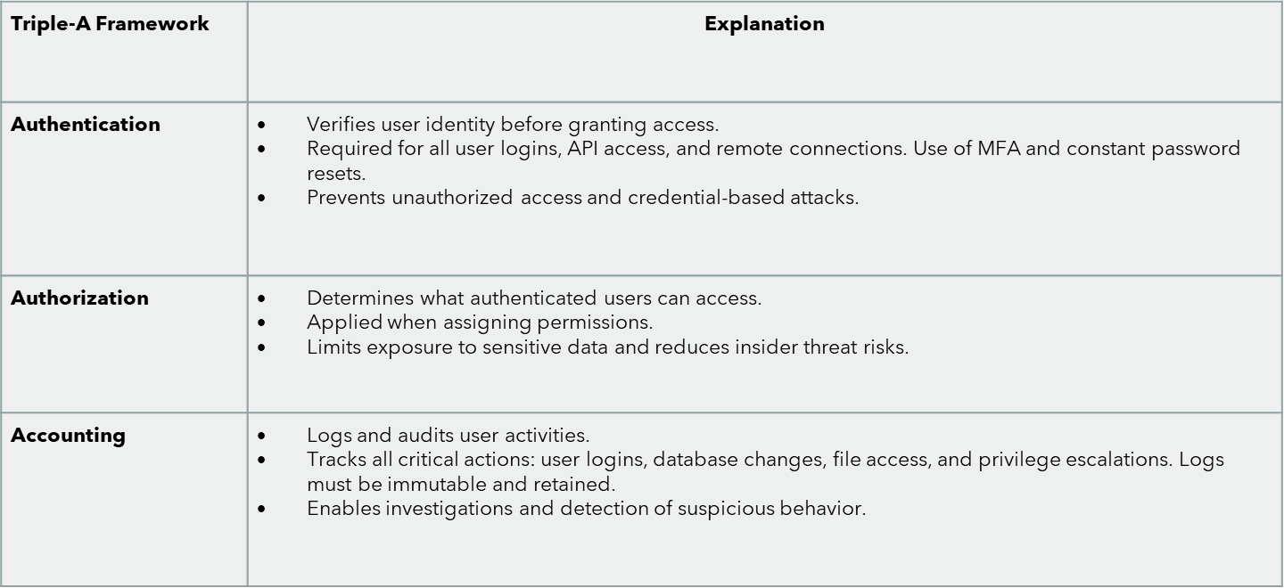
TRIPLE-A POLICIES

Slide 8
Unit Test #1
TEST_F(CollectionTest, ValidateInputData_DoesNotAcceptInvalidAccess)
{
add_entries(3);
// Accessing out-of-bounds — collection only has 3 elements (0-2)
// This should throw, but we'll write it to expect a failure by using EXPECT_NO_THROW
// which is incorrect, thus the test will fail.
EXPECT_NO_THROW(collection->at(5)); // <-- This should fail
}

Slide 9
Unit Test #2
TEST_F(CollectionTest, DefaultDeny_AccessEmptyCollectionThrows)
{
// The collection is empty by default, and any access attempt should be denied.
EXPECT_THROW(collection->at(0), std::out_of_range);
}

Slide 10
Unit Test #3
TEST_F(CollectionTest, KeepItSimple_CheckSizeAfterPushBack)
{
collection->push_back(1);
ASSERT_EQ(collection->size(), 1);
}

Slide 11
Unit Test #4
TEST_F(CollectionTest, DefenseInDepth_CheckEmptyBeforeAndAfterClear)
{
add_entries(5);
ASSERT_FALSE(collection->empty()); // First layer check: not empty
collection->clear();
ASSERT_TRUE(collection->empty()); // Second layer check: cleared successfully
}

Slide 12
Unit Test #5
TEST_F(CollectionTest, SanitizeData_RemoveNegativeValuesBeforeSending_Fails)
{
collection->push_back(10);
collection->push_back(-50);
collection->push_back(25);
// Deliberately NOT sanitizing
for (const auto& val : *collection)
{
ASSERT_GE(val, 0); // This fails on -50
}
}

Slide 13
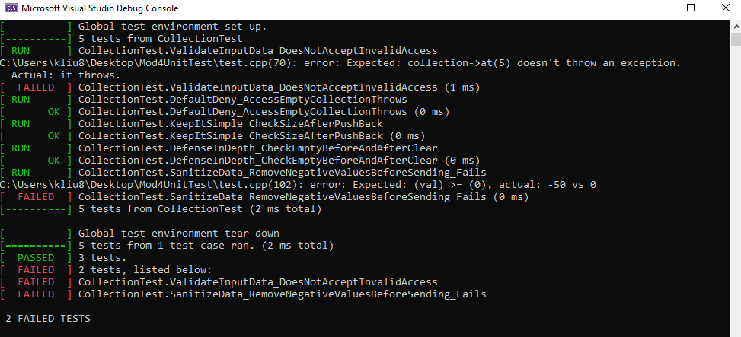
Result

Slide 14

AUTOMATION SUMMARY

Slide 15
TOOLS

Slide 16
RISKS AND BENEFITS
Benefits of Immediate Implementation:
• Reduces risk of exploits like injection, privilege escalation, and data leaks.
• Lowers long-term costs by catching vulnerabilities early.
• Promotes code clarity and maintainability (Keep It Simple).
• Strengthens system resilience via Defense in Depth.
• Ensures regulatory compliance through standardization.
Risks of Delaying Implementation:
• Increases exposure to zero-day attacks and known exploits.
• Weak input/data validation opens doors to injection attacks.
• Developer reliance on insecure habits or outdated practices.
• Higher technical debt and costly post-release patches.
• Missed opportunity for early threat detection via QA and audits.

Slide 17
RECOMMENDATIONS
No policy on secure third-party dependencies – External libraries may introduce hidden vulnerabilities.
Limited focus on runtime protection – Our current policy covers build-time checks but lacks strategies for monitoring behavior during execution.
Insufficient logging/auditing standards – Without detailed logs, tracing incidents is difficult post-breach.
Adopt Software Composition Analysis (SCA) to scan and verify third-party code
Introduce runtime application self-protection (RASP) tools for live threat detection.
Enforce centralized logging and SIEM integration for real-time alerting and historical analysis.

Slide 18
CONCLUSIONS
Our secure coding policy lays the foundation for minimizing risk.
By expanding our scope to include runtime, dependency management, and continuous monitoring, we can proactively prevent future breaches.
With automation and strong security culture, we position ourselves for long-term protection and compliance.

Slide 19
REFERENCES
Microsoft. (2023). Zero Trust security model. https://www.microsoft.com/en-us/security/business/zero-trust
OWASP Foundation. (2021). Application Security Verification Standard 4.0.3. https://owasp.org/www-project-application-security-verification-standard/
OWASP Foundation. (2023). OWASP Dependency-Check. https://owasp.org/www-project-dependency-check/
OWASP Foundation. (2021). OWASP Top 10: 2021 – The Ten Most Critical Web Application Security Risks. https://owasp.org/Top10/

